Slide 1
WEB 322 WEB PROGRAMMING TOOLS AND FRAMEWORKS
Week 7 – Lecture 2
Introduction to jQuery & Bootstrap

Slide 2

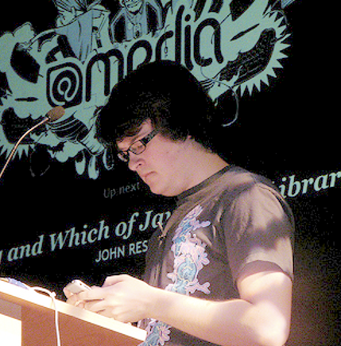
Popular JS library created in January 2006 by John Resig.
Influenced by Dean Edwards’ cssQuery library.
Simplifies tasks like DOM manipulation, Event Handling & AJAX.
There is a large community of developers working on open-source “plug-ins” for jQuery.
https://jquery.com/
John Resig

Slide 3
Installing jQuery
Add a script reference to jQuery in the HTML <head>
Download the source files
<script src="/js/lib/jQuery/jquery-3.5.1.min.js"></script>
Use a CDN (Content Delivery Network)
<script
src="https://code.jquery.com/jquery-3.5.1.min.js"
integrity="sha256-9/aliU8dGd2tb6OSsuzixeV4y/faTqgFtohetphbbj0="
crossorigin="anonymous"></script>

Slide 4
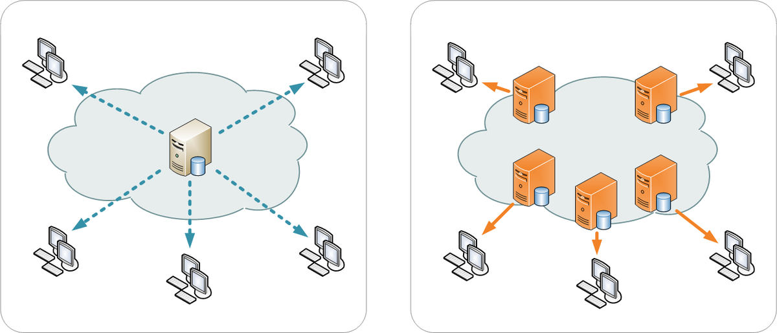
Content Delivery Networks (CDN)
Offer a performance benefit by hosting scripts on servers spread across the globe.
If the visitor to your webpage has already downloaded a copy of a script from the same CDN, it won't have to be re-downloaded.
There may be delays between the official site release and release on a CDN.
Popular CDNs
Google CDN
Microsoft CDN
CDNJS CDN
jsDelivr CDN

Slide 5
Client-Side JavaScript
With the jQuery library in place, add an external JS file that uses the library.
Include our script beneath jQuery.
If we accidentally place code that uses jQuery before the library is loaded, we will get errors.
We must include all external JS files that will be using the jQuery library beneath our jQuery script.

Slide 6

“$” in jQuery
The “$” is a shortcut for jQuery, used more often than writing out the full syntax:
jQuery(function() { … });
Other JS libraries may conflict with the use of the “$” so we can use .noConflict() and always write full syntax instead.
$(document).ready()
Anonymous callback function.
Executed when the DOM is ready / safe to manipulate.
In other words, DOM is ready for JavaScript execution.
$(function() { … }); // An even shorter syntax

Slide 7
jQuery Selectors
Use CSS-style syntax to query the DOM.
Like document.querySelector() and document.querySelectorAll() with additional selectors.
Wrap native DOM elements, introducing additional functionality to work with elements.
https://api.jquery.com/category/selectors/

Slide 8
Common jQuery Selectors
$("element") – Selects all elements of a given type.
$("#elementId") – Selects a single element with the given ID.
$(".className") – Selects all elements with the given class.
$(":input") – Selects all input, textarea, select and button elements.
$(":radio") – Selects all elements of type radio.
$(":checkbox") – Selects all elements of type checkbox.
$(":visible") – Selects all elements that are visible.
$(":hidden") – Selects all elements that are hidden.
$(":has(selector)") – Selects elements containing at least one element.

Slide 9
Access each element
$("ul.myList li").each(function(index) { // DO NOT use arrow notation here … () => {} $(this).append(" " + index); });

Slide 10
Filter results
// make all odd <li> elements inside <ul class=“myList">...</ul> bold
$("ul.mylist li").filter(":odd").css("font-weight", "bold");

Slide 11

Event Handling
Execute code when a certain “event” occurs
Typical events include button presses, form submission, and input value changes.
Register a callback function for events you want to handle (aka: wire-up events).
In jQuery, use .on() to register an event or .off() to stop listening to events.
Using .on() will allow dynamically added elements to receive events as well.

Slide 12
Event Handling Example
$(function () {
$("ul.mylist").on("click", "li", function () {
// DO NOT use () => {} syntax here
$(this).css("color", "red");
});
$("ul.mylist").append("<li>I get the event too!</li>");
});
$(function () {
$("ul.mylist").off("click", "li");
});

Slide 13
DOM Modification
.css() – Get or set the value of a computed style property.
.attr() – Get or set the value of an attribute.
.prop() – Get or set one or more properties.
.addClass() – Add the specified classes. Remove using .removeClass().
$('', {}) – Create a new element by suppling an HTML string.
.append() – Insert content to the end of an element.
.remove() – Remove elements from the DOM.

Slide 14
More DOM Modifications
.text() – Get or set the text contents of elements.
.html() – Get or set the HTML contents of elements.
.val() – Get or set the value of input elements.
https://api.jquery.com/category/manipulation/

Slide 15
AJAX
jQuery provides a $.ajax() method to perform AJAX requests.
Very popular approach before the Fetch API was introduced
Allowed a standardized approach to making AJAX requests.

Slide 16
Using Fetch API
fetch("https://reqres.in/api/users", {
method: "POST",
body: JSON.stringify({ name: "John Doe", job: "unknown" }),
headers: {
"Content-Type": "application/json"
}
})
.then(response => response.json())
.then(json => { console.log(json); })
.catch(err => { console.log(err); });

Slide 17
Using jQuery $.ajax()
$.ajax({
url: "https://reqres.in/api/users",
type: "POST",
data: JSON.stringify({ name: "John Doe", job: "unknown" }),
contentType: "application/json"
})
.done(function (data) {
console.log(data);
})
.fail(function (err) {
console.log("error: " + err.statusText);
});

Slide 18

Bootstrap is a popular framework that helps us develop responsive and mobile-compatible web apps.
It was created by Mark Otto and Jacob Thornton (of Twitter).
It is an open-source project.
You can read more about Bootstrap in this Wikipedia article.

Slide 19
Bootstrap is a Framework
At its core, it is a set of CSS rules. Most are implemented as element and class selectors.
It enables us to have visual consistency on web pages. It’s Bootstrap that affects the appearance of our web app.
The navigation menu, layout characteristics, comfortable spacing, nice clear buttons, rounded-corner text input fields on HTML Forms, and responsiveness for different screen sizes – all come from Bootstrap.
Excellent documentation to help developers prototype web apps quickly.

Slide 20
Including Bootstrap in our Projects
Like jQuery, simply add external JS and CSS files to our views.
Bootstrap depends on jQuery so you must include Bootstrap after jQuery.
You can install it locally or using a CDN.
See the web322.ca website for syntax.

Slide 21
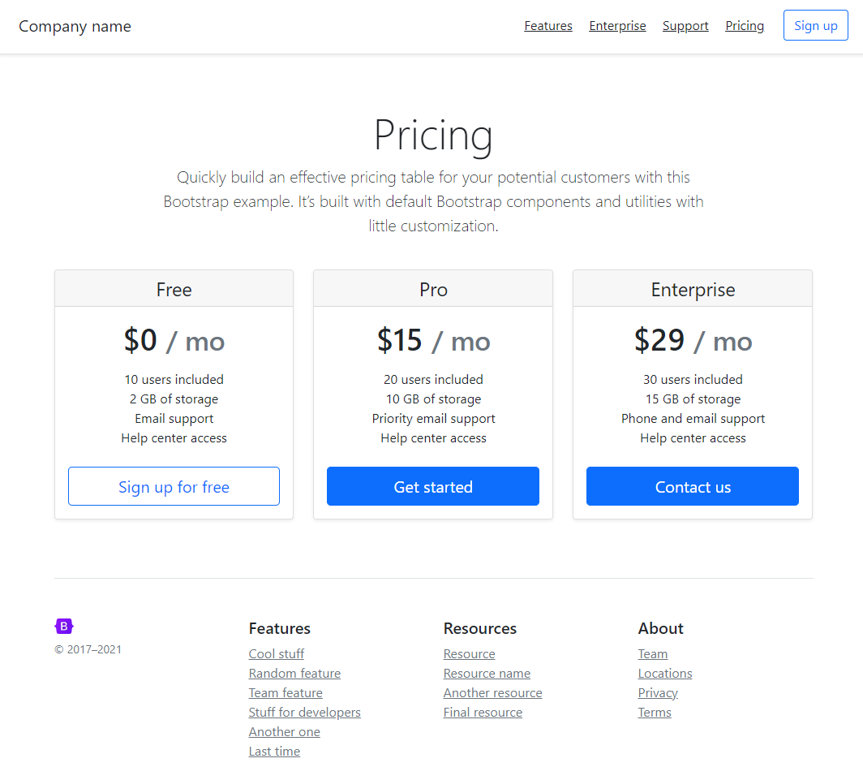
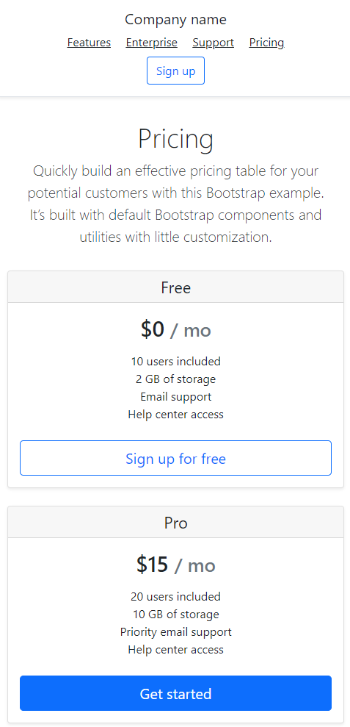
Bootstrap is Responsive

Slide 22
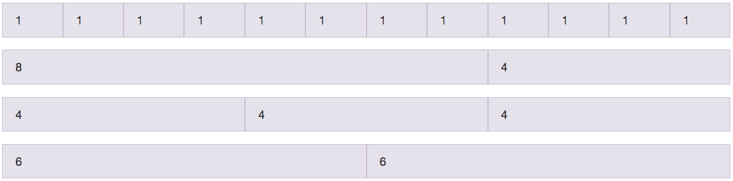
Responsive Grid System
Uses a CSS grid system.
Allows developers to create visually pleasing, clean layouts without manually implementing floats, margins, madding or flexbox.
Place columns in rows and rows in containers.
Each row has twelve columns.

Slide 23
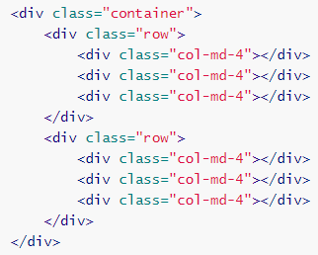
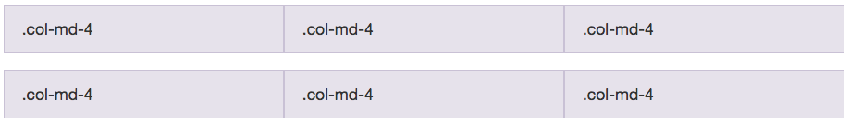
Example of a 3x2 Grid
You can specify viewport specific configurations
col-xs-*
col-sm-*
col-md-*
col-lg-*

Slide 24
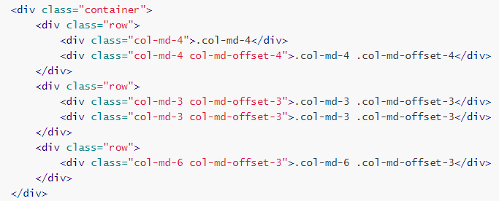
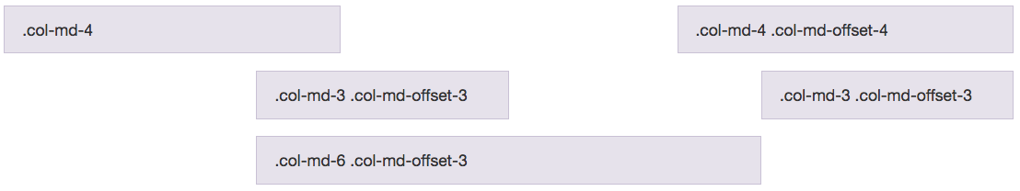
Offsetting Columns

Slide 25
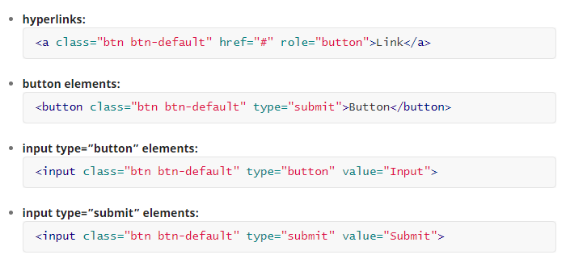
Buttons

Slide 26
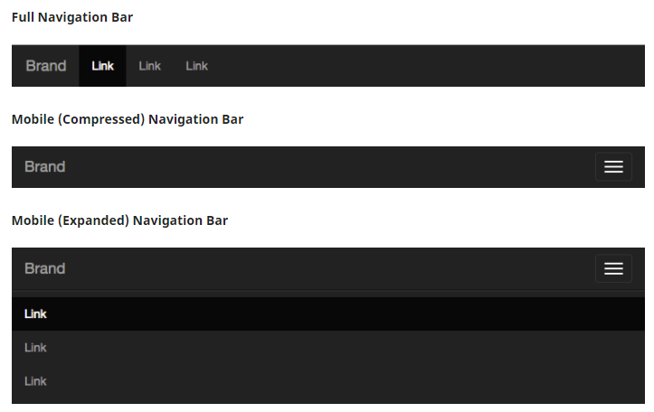
Navigation Bar

Slide 27
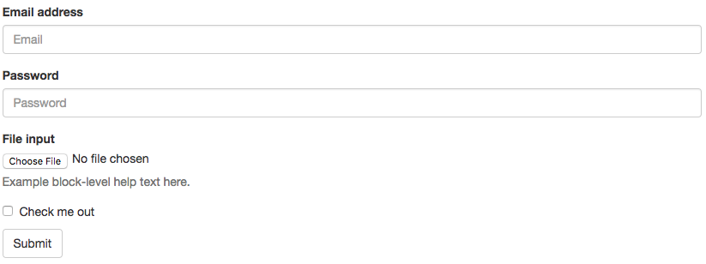
Forms

Slide 28
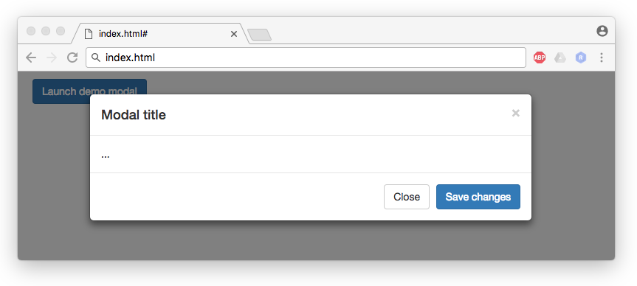
Modals

Slide 29

Live Demo
jQuery
Setup jQuery.
Select elements in the DOM.
Wire-up event handlers.
Manipulate the DOM.
Bootstrap
Basic bootstrap.

